Slide 1
Software Engineering Introduction

Slide 2
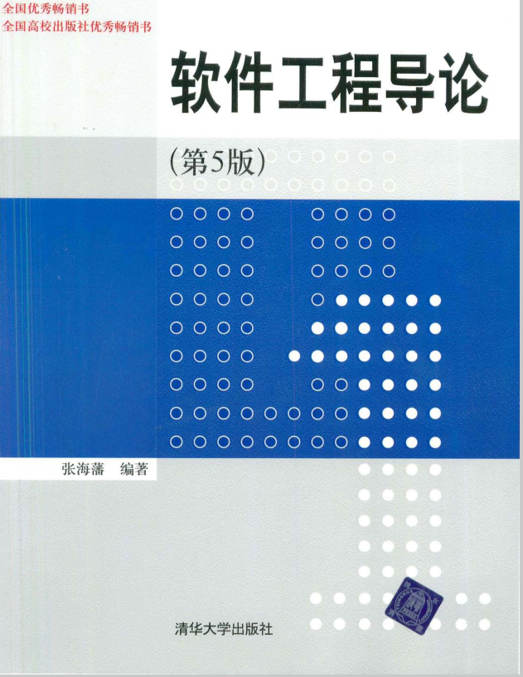
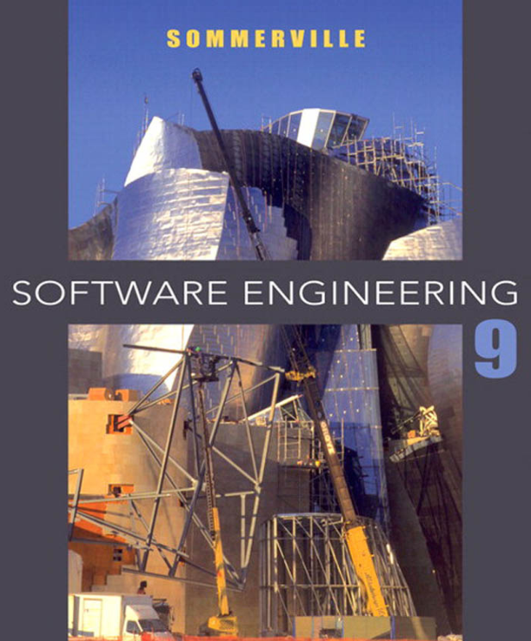
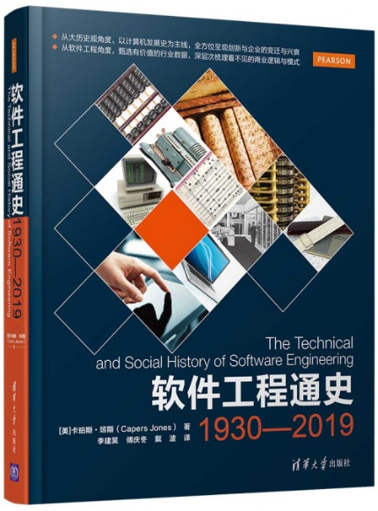
SCHEDUE
32学时＝8周 x 4 学时/周
期末考试（70％）+平时（30％）
平时=出勤+作业+讨论
教材：软件工程导论（第5版或第6版），张海藩，清华大学出版社

Slide 3
PURPOSE
As an important professional course of computer science, we hope:
To develop software systems with engineering principles and methods, combine professional knowledge with practical projects, and lay a solid foundation for the development, application and maintenance of computer software in the future.
To cultivate students' software quality and improve their software development ability and software project management ability.

Slide 4
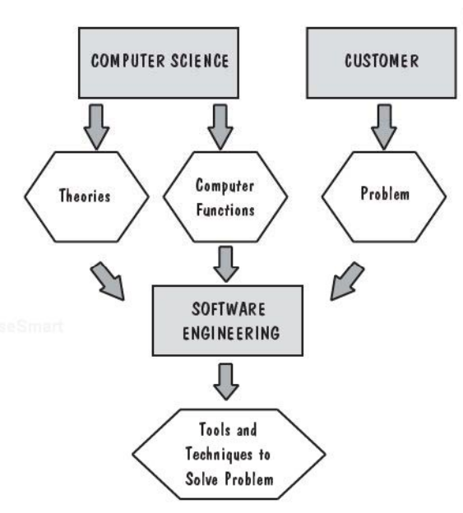
Computer science and Software engineering
Investigating hardware design.
Investigating how algorithm works.
A software engineer considers the computer as a tool, a part of solution.

Slide 5
THIKING
Please considering the follow questions:
Is the software equal to the program?
Can you write programs and develop software?
Can you manage software production if you can develop software?
What qualities and abilities do software engineers need?
What qualities and abilities do software project managers need?

Slide 6
Chapter 1 Software Engineering Overview

Slide 7
Phases of computer development
Time | Hardware | Software
First generation Before the mid-1960s | Transistor computer (晶体管) | Program design stage Individualized production
Second generation Mid-1960s to mid-1970s | Integrated circuit computer (集成电路计算机) | Program system phase Workshop production Software crisis Birth of software engineering
Third generation Mid-1970s to mid-1980s | Microprocessor personal computer (微处理器个人计算机) | Software engineering stage Engineering thought Distributed system
Fourth generation Since the mid-1980s to now | Object oriented phase (面向对象阶段) Hardware and software integration(硬件与软件综合) The fourth generation technology of software development (软件开发第四代技术)

Slide 8
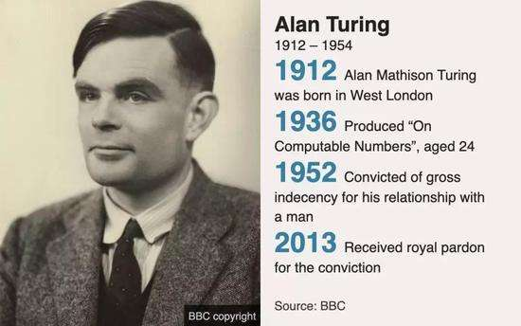
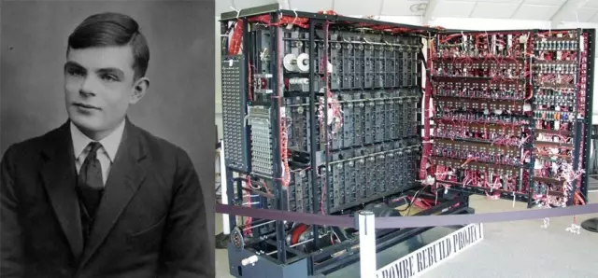
Alan Mathison Turing—艾伦·麦席森·图灵

Slide 9
Definition of computer system
The collection of a series of system elements that are properly organized together. These system elements works together and cooperate with each other to complete the predefined goals through the processing of information.
Program (instruction set): executable code, composed of characters, numbers, etc.
Data: Input and output data (temporary and permanent data)
Relevant documents: specification documents, design documents, user manuals and other management documents
Software
Hardware
Personnel: users and operators
Database
File: Manuals, tables, graphics and other descriptive information
Else
Electronic computing equipment
Electromechanical equipment
Is the software equal to the program?
computer system

Slide 10
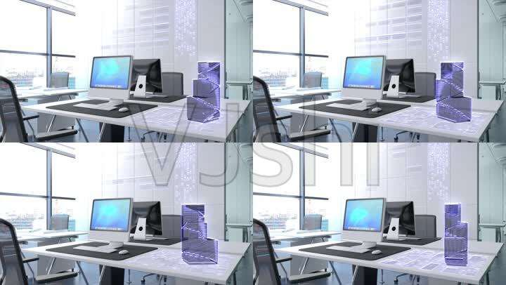
Computer
Computer is a general tool composed of electronic components and circuits, which can be used to solve problems. However, to turn people's creative idea of solving problems into the actual operation steps of the computer, there are many links to go through. The most important one is to turn people's idea of solving problems into a program that can be executed by the computer.

Slide 11
Software and program
Program is realized by programming language. In low-level programming languages such as machine language and assembly language, a program is a group of ordered instruction sequences and related data; In a high-level programming language, a program is usually a set of instructions and statements. The program must be loaded into the computer to actually work.
Software is a general term for programs and documents in computer systems. A program is a description of the processing objects and processing rules of a computing task. A document is an explanatory material required for understanding the program, such as a design specification, a user's Guide (user's manual), and so on. The program must be loaded into the computer to work. The documents are generally for people to see, and do not have to be loaded into the machine.

Slide 12
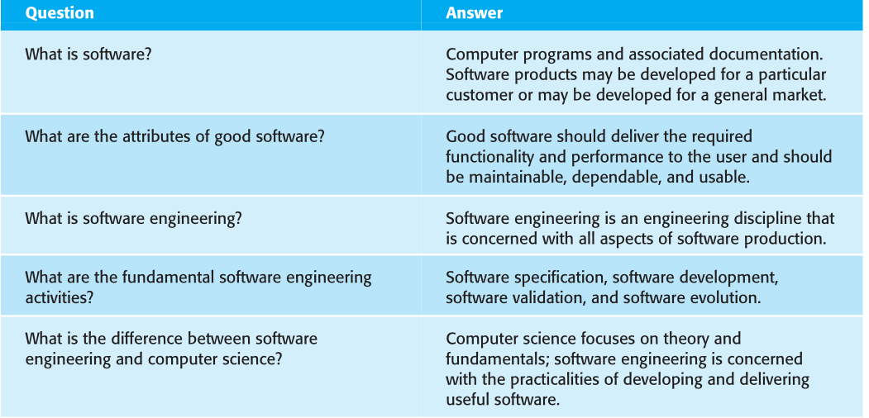
Several questions

Slide 13
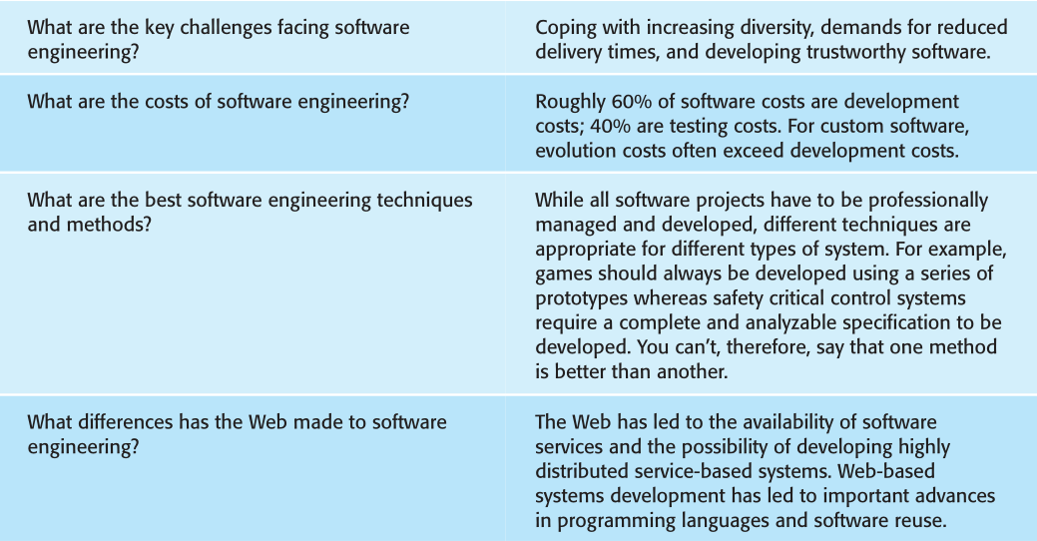
Several questions

Slide 14
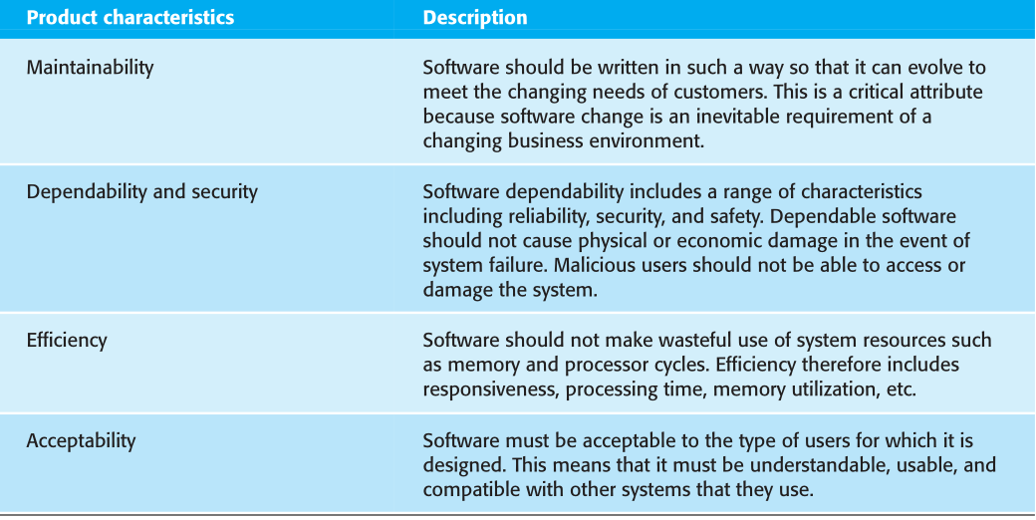
Several questions

Slide 15
Software Characteristics
Abstract: logical entity is not physical entity (not intuitive);
Indefinite use: There is no wear and tear problem, and it can be;
Portability: zero cost unlimited replication;
Complexity: implementation and maintenance are becoming more and more complex;
Expensive: high development and maintenance costs;

Slide 16
Comparison of software and hardware wear
修改点
失效率
磨合调整
失效率
实际曲线：软件需求不断增加
磨损用坏
理想曲线：理论后期不受时间影响
时间
时间
硬件失效率曲线
软件失效率曲线

Slide 17
1. Software Engineering Overview
1.1 software crisis
1.2 software engineering
1.3 software life cycle
1.4 software process

Slide 18
1.1 software crisis — introduction
In the 1940s, mathematicians and electronic engineers developed computers to meet the needs of scientific computing;
In the 1960s, some American universities opened computer majors to teach how to write software. The initial software function is relatively simple, mainly completed by individuals without relevant documents;
After the 1970s, software workshops began to appear, and software was developed according to the demand. However, due to the rapid increase of the number, the difficulty of development and maintenance increased sharply, and more and more problems appeared.
In 1968, computer scientists of NATO held an International Conference on computer science, put forward the concept of "software crisis" and proposed the discipline of "software engineering".

Slide 19
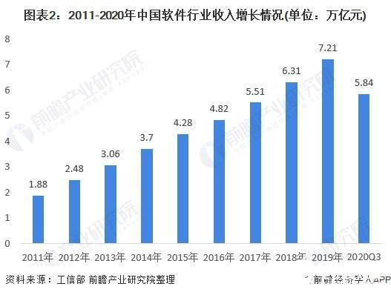
1.1 software crisis — introduction
Software crisis includes the following two aspects:
How to develop software to meet the growing demand for software;
How to maintain the expanding number of existing software.
软件危机包含下述两方面的问题：
如何开发软件，满足对软件日益增长的需求；
如何维护数量不断膨胀的已有软件。

Slide 20
1.1 software crisis — introduction
A series of serious problems were encountered in the development and maintenance of computer software. (计算机软件的开发和维护过程中遇到的一系列严重问题)
Estimation of cost and progress is usually inaccurate.
The user is unsatisfied with the “completed” software system.
Software quality is usually unreliable.
Software is un-maintainable.
No documentation is available.
Software takes more and more proportion of the total cost of the computer system.
Software development does not match the rapid, deeper and wider computer application.

Slide 21
1.1 software crisis — Why?
Related to the software itself — Characteristics
Logic components: it is difficult to evaluate the quality and difficult to manage, develop and maintain;
Large scale: cumbersome development (开发繁琐), multi-person division of labor and cooperation, involving technical and management issues;

Slide 22
1.1 software crisis — Why?
Related to the software itself — Performance:
Software will not be "worn out". If errors are found, they are likely to be introduced during the development period; (软件本身不会因为使用而磨损。如果出现问题，很可能是在开发期间引入的。也就是说，如果软件出现错误或缺陷，通常是在开发过程中的程序设计或编写阶段出现的。)
The software scale is huge, and the complexity of the program will increase exponentially with the increase of the program scale. How to ensure that the work completed by each person can indeed form a high-quality large-scale software system is an extremely complex and difficult problem. This not only involves many technical issues, such as analysis methods, design methods, formal description methods, version control, etc., but also requires strict and scientific management.
Notes:
https://xbeibeix.com/api/bilibili/ 视频解析

Slide 23
1.1 software crisis — Why?
Related to incorrect software development and maintenance
Early software development has the characteristics of individualization. The understanding of software development and maintenance is wrong, resulting in a series of problems.
Ignoring the importance of software requirement analysis. Without a complete and accurate understanding of the user's requirements, they hurried to write the program. The earlier you start writing a program, the longer it takes to complete it.

Slide 24
1.1 software crisis — Why?
Related to incorrect software development and maintenance
People believed that software development is about writing programs and trying to make them work. The program is only one part of a complete software product. A software product must be composed of a complete configuration(完整的配置), which mainly includes programs, documents, and data. The cost of modification in different stages of software development is very different.
Despise software maintenance(轻视软件维护). Maintenance is extremely arduous(繁重) and complex work, which requires a great cost. The cost of software maintenance accounts for 55% ~ 70% of the total cost of the software. An important goal of software engineering is to improve the maintainability of software and reduce the cost of software maintenance.

Slide 25
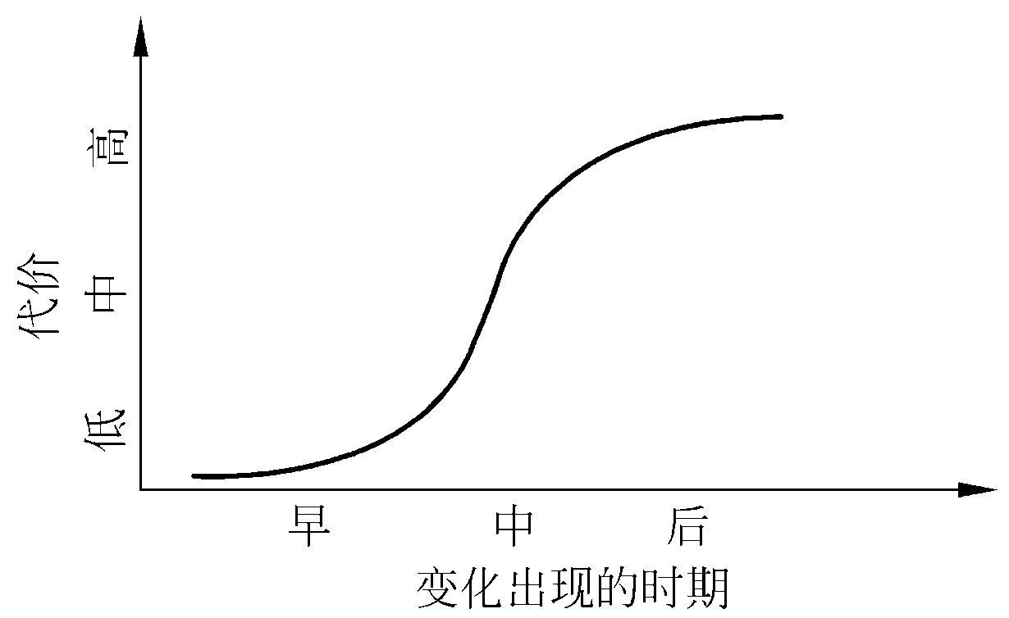
Correction cost — An error was found at different stage

Slide 26
Software development failure cases
1962年，水手号火箭的致命BUG。经济损失：1850万美元。 1962年，携带空间探测器的水手1号火箭前往金星，在起飞后不久就偏离了预定航线。任务控制在起飞293秒后摧毁了火箭。事故的起因就在于一名程序员把一条手写的公式抄写为错误的计算机代码。从而将火箭引导偏离了航向。
1978年, 哈特福德体育场倒塌事件。经济损失: 7000万美元 1978年, 在上万球迷离开哈特福德体育场几小时后, 体育场屋顶就被雪压塌了. 起因在于分析受力的程序错误地假设钢结构屋顶的支撑仅承受纯压力. 但当其中一个支撑因大学塌了后,导致连锁反应, 从而导致整个体育场的塌陷.
1983年, 苏联导弹预警系统错误地报告遭到美国发射的5枚导弹攻击. 但幸运的是,当时的负责人认为如果美国真的要攻击的话, 发射的决不只是5枚导弹.

Slide 27
Software development failure cases
计算机2000年问题，又叫做“千年虫”、“电脑千禧年千年虫问题”或“千年危机”。缩写为“Y2K”。是指在某些使用了计算机程序的智能系统（包括计算机系统、自动控制芯片等）中，由于其中的年份只使用两位十进制数来表示，因此当系统进行（或涉及到）跨世纪的日期处理运算时（如多个日期之间的计算或比较等），就会出现错误的结果，进而引发各种各样的系统功能紊乱甚至崩溃。
Notes:
因此从根本上说千年虫是一种程序处理日期上的bug（计算机程序故障），而非病毒。“千年虫”问题的根源始于60年代。当时计算机存储的成本很高，如果用四位数字表示年份，就要多占用存储器空间，就会使成本增加，因此为了节省存储空间，计算机系统的编程人员采用两位数字表示年份。随着计算机技术的迅猛发展，虽然后来存储器的价格降低了， 但在计算机系统中使用两位数字来表示年份的做法却由于思维上的惯性势力而被沿袭下来， 年复一年，直到新世纪即将来临之际，大家才突然意识到用两位数字表示年份将无法正确辨识公元2000年及其以后的年份。1997年，信息界开始拉起了“千年虫”警钟，并很快引起了全球关注。

Slide 28
1.1 software crisis — How to eliminate?
A correct understanding of computer software, eliminating the wrong understanding that "software is a program".
Recognize that software development is an engineering project with good organization, strict management, cooperation and cooperation of all kinds of personnel, and the existing experience should be fully learned.
Popularize the successful technologies and methods of software development summarized in practice, and continue to research and explore.
Better software tools should be developed and used.
To solve the software crisis, both technical measures (Methods and tools) and necessary organizational management measures are required.
既要有技术措施(方法和工具)，又要有必要的组织管理措施。

