Slide 1
Software Engineering Introduction

Slide 2

1. Software Engineering Overview
1.1 software crisis
1.2 software engineering
1.3 software life cycle
1.4 software process

Slide 3
1.4 software process
Definition: it is a framework of a series of tasks that need to be completed in order to obtain high-quality software. It specifies(规定了) the work steps to complete various tasks.
The process defines sequences of application methods, documents to be delivered, the management measures to be taken to ensure the software quality and coordinate changes, and the milestones to mark the completion of tasks in each stage of software development.
To obtain high-quality software products, the software process must be scientific and effective.
Notes:
该过程定义了应用方法的顺序、要交付的文件、为确保软件质量和协调变化而采取的管理措施，以及标志软件开发各阶段任务完成的里程碑。

Slide 4
1.4 software process
瀑布模型：Waterfall model
快速原型模型：Rapid prototype model
增量模型：Incremental model
螺旋模型：Spiral model
喷泉模型：Fountain model

Slide 5
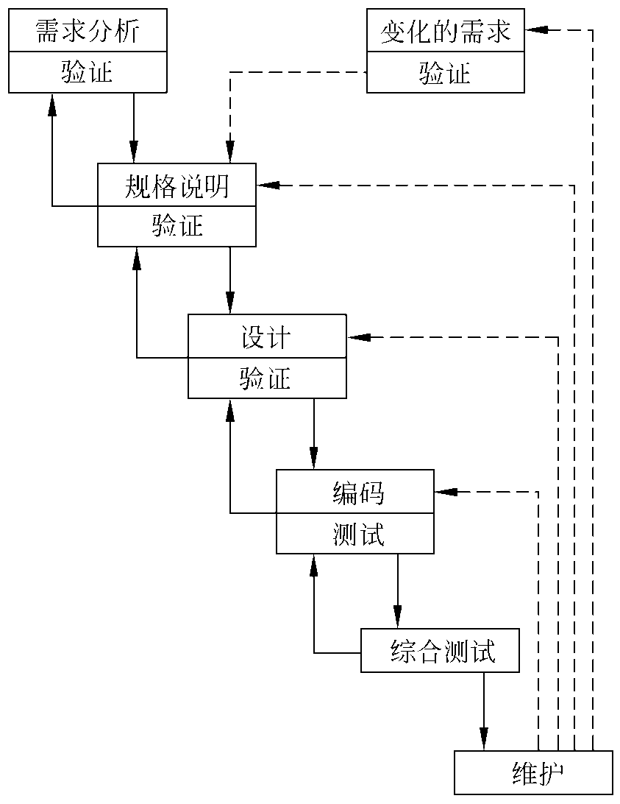
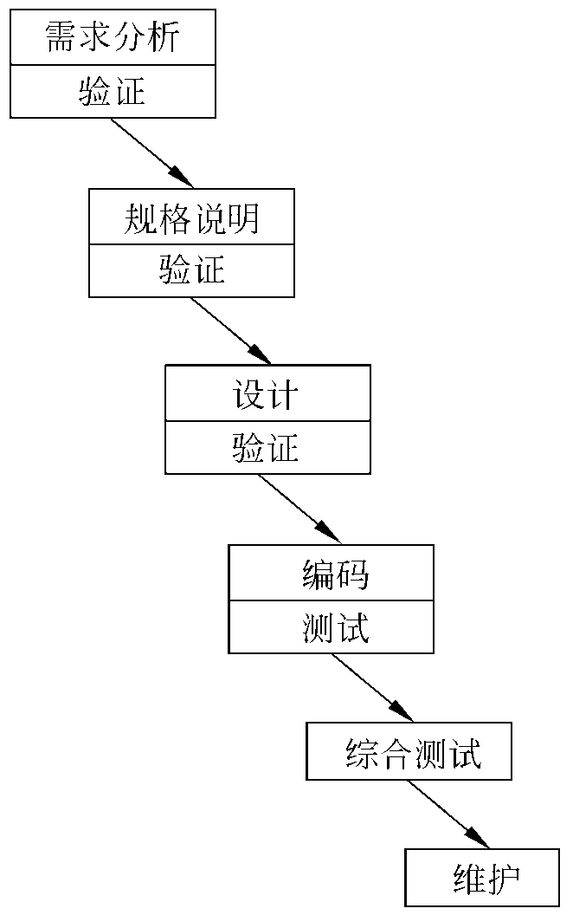
1.4 software process— Waterfall model
传统的瀑布模型
实际的瀑布模型
Notes:
瀑布模型教学视频
https://www.bilibili.com/video/BV1Yv41157ue/?spm_id_from=333.999.0.0&vd_source=5b7bb1bed30e4526843357020c19819e

Slide 6
Characteristics of waterfall model
The phases are sequential and dependent
The work of the next stage can only be started after the work of the previous stage is completed;
The output document of the previous stage is the input document of the next stage.
Viewpoint of delaying realization
For large-scale software projects, the earlier the coding starts, the longer it takes to complete the development work.
Viewpoint of quality assurance
Each stage must complete the specified documents, which is a "document driven" model;
Before the end of each phase, the completed documents shall be reviewed to find problems and correct errors as soon as possible.
Notes:
1. 各个阶段是有顺序的，也是相互依赖的
下一阶段的工作只有在前一阶段的工作完成后才能开始；
前一阶段的输出文件是下一阶段的输入文件。
2. 推迟实现的观点
对于大型软件项目，越早开始编码，完成开发工作的时间就越长。
3. 质量保证的观点
每个阶段都必须完成指定的文档，这是一种 "文档驱动 "的模式；
在每个阶段结束前，应审查已完成的文件，尽快发现问题并纠正错误。

Slide 7
Characteristics of waterfall model
Advantages of waterfall model:
Developers can be forced to adopt standardized methods;
Strictly specify the documents that must be submitted at each stage;
It is required that all products delivered at each stage must be carefully verified by the quality assurance team.
Disadvantages of waterfall model:
It is impractical to understand the product only through documents and not through practice.
Overall, the waterfall model is applicable to: Demand is predictable; The software implementation method is mature; The project cycle is short.
Notes:
瀑布模式的优点：
可以强迫开发者采用标准化的方法；
严格规定每个阶段必须提交的文件；
要求每个阶段交付的所有产品都必须经过质量保证小组的仔细验证。
瀑布模型的劣势：
只通过文件而不通过实践来了解产品，这是不现实的。
总的来说，瀑布模型适用于： 需求是可预测的；软件实施方法是成熟的；项目周期短。

Slide 8
1.4 software process— Rapid prototyping model
Rapid prototyping: it is a program that can be quickly established and run on a computer. The functions it can complete are often a subset of the functions that the final product can complete. It is an initial version of a software system that is used to demonstrate concepts, try out design options, and find out more about the problem and its possible solutions.
听取用
户意见
建造/修改原型
原型实现范型
用户测试运行原型
Notes:
快速原型设计：它是一个可以快速建立并在计算机上运行的程序。它所能完成的功能往往是最终产品所能完成的功能的一个子集。它是一个软件系统的初始版本，用来演示概念，尝试设计方案，并找出更多关于问题及其可能的解决方案。

Slide 9
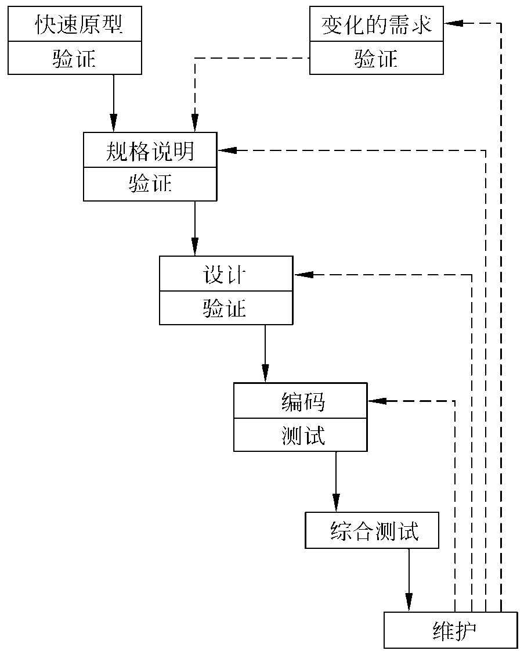
1.4 software process— Rapid prototyping model
Features of rapid prototyping model:
The rapid prototyping model has no feedback loop, and the development of software products is basically carried out in a linear sequence.
The essence of rapid prototyping is "fast". The prototype system should be built as soon as possible to speed up the software development process and save costs.
快速原型模型是不带反馈环的，这正是这种过程模型的主要优点：软件产品的开发基本上做到线性顺序进行的
Notes:
快速原型开发模式的特点：
快速原型开发模式没有反馈回路，软件产品的开发基本上是按线性顺序进行的。
快速原型开发的本质是 "快"。应尽快建立原型系统，以加快软件开发过程，节约成本。

Slide 10
1.4 software process— Rapid prototyping model
Why it is a linear sequence?
The prototype system has been verified by interacting with the user, and the specification documents generated thereby correctly describe the user's requirements. Therefore, in the subsequent stages of the development process, there will be no major rework due to the discovery of errors in the specification documents.
Developers have learned a lot by establishing the prototype system (at least they know "what the system should not do and how not to do what it should not do"). Therefore, the possibility of errors in the design and coding stages is relatively small, which naturally reduces the possibility of correcting the errors made in the previous stages in the subsequent stages.
Notes:
为什么它是一个线性序列？
原型系统已经通过与用户的互动得到了验证，由此产生的规范文件正确描述了用户的需求。因此，在开发过程的后续阶段，不会因为发现规范文件中的错误而出现重大返工。
开发人员通过建立原型系统学到了很多东西（至少他们知道 "系统不应该做什么以及如何不做它不应该做的事情"）。因此，在设计和编码阶段出现错误的可能性相对较小，这自然减少了在后续阶段纠正前面阶段所犯错误的可能性。

Slide 11
1.4 software process— Rapid prototyping model
Once the software product is delivered to the user for use, maintenance begins. Depending on the types of maintenance work to be completed, it may be necessary to return to different stages such as demand analysis, specification, design, or coding, as shown by the dotted arrow in the right figure.
Notes:
一旦软件产品被交付给用户使用，维护工作就开始了。根据要完成的维护工作的类型，可能需要回到不同的阶段，如需求分析、规范、设计或编码，如右图中的虚线箭头所示。

Slide 12

1.4 software process— Rapid prototyping model

Slide 13
1.4 software process— Incremental model
1
交流
Incremental model takes software products as a series of incremental components to design, code, integrate and test.
Each component is composed of multiple interacting modules and can perform specific functions.
2
计划
软件功能性和特征
3
建模（分析，设计）
增量n
4
构造（编码，测试）
1
2
5
部署（发布，反馈）
3
4
5
第n次增量发布
增量2
┇
增量1
1
2
3
4
1
5
第2次增量发布
2
3
4
5
第1次增量发布
项目日历时间
Notes:
增量模型将软件产品作为一系列增量组件来设计、编码、集成和测试。
每个组件都是由多个相互作用的模块组成，并能执行特定的功能。

Slide 14

Example: Word processing software
1st incremental component: basic file management, editing and document generation functions;
2nd incremental component: more complete editing and document generation functions;
3rd incremental component: spelling and grammar checking functions;
4th incremental component: advanced page layout function.
When using the incremental model, the first incremental component often realizes the basic requirements of the software and provides the most core functions.
Constraint condition: when new components are integrated into existing software, the products formed must be testable.
Notes:
第1个递增组件：基本的文件管理、编辑和文件生成功能；
第2个增量部分：更完整的编辑和文件生成功能；
第3个增量部分：拼写和语法检查功能；
第4个递增组件：高级页面布局功能。
在使用增量模型时，第一个增量组件往往实现了软件的基本需求，提供了最核心的功能。
约束条件：当新的组件被集成到现有的软件中时，形成的产品必须是可测试的。

Slide 15
1.4 software process— Incremental model
Advantage:
It is an advantage of the incremental model that products that can complete part of the work can be submitted to the user in a relatively short time.
When the assigned personnel cannot complete the product within the set time limit, it provides a way to launch the core product first.
Another advantage of the incremental model is that the gradual addition of product functions allows users to have more time to learn and adapt to new products, thus reducing the impact that brand-new software may bring to the customer.
Notes:
优势：
1. 能完成部分工作的产品可以在较短的时间内提交给用户，这是增量模式的一个优势。
2. 当指定的人员不能在规定的时间内完成产品时，它提供了一种先推出核心产品的方式。
3. 增量模式的另一个优点是，产品功能的逐步增加使用户有更多的时间来学习和适应新产品，从而减少全新的软件可能给客户带来的影响。

Slide 16
1.4 software process— Incremental model
Difficulty:
The software architecture must be open: When integrating each new incremental component into the existing software architecture, it must not destroy the originally developed products.
The model itself is self-contradictory. Integral - independent component. (它一方面要求开发人员把软件看作一个整体，另一方面又要求开发人员把软件看作构件序列，每个构件本质上都独立于另一个构件)
Building different components in parallel may speed up the progress of the project but at the risk of not being integrated together.
Notes:
难度：
软件架构必须是开放的： 当把每个新的增量组件整合到现有的软件架构中时，不能破坏原来开发的产品。
该模型本身是自相矛盾的。整体--独立组件。(它一方面要求开发人员把软件看作一个整体，另一方面又要求开发人员把软件看作构件序列，每个构件本质上都独立于另一个构件)
平行建造不同的组件可能会加快项目的进度，但有可能无法整合在一起。

Slide 17

1.4 software process— Incremental model
It is applicable to the software development process with changing requirements.
Incremental models are particularly useful in situations where it is not possible to find enough developers before the project's established business requirements deadline.
Notes:
它适用于需求不断变化的软件开发过程。
递增模型在项目既定的业务需求期限之前不可能找到足够的开发人员的情况下特别有用。

Slide 18
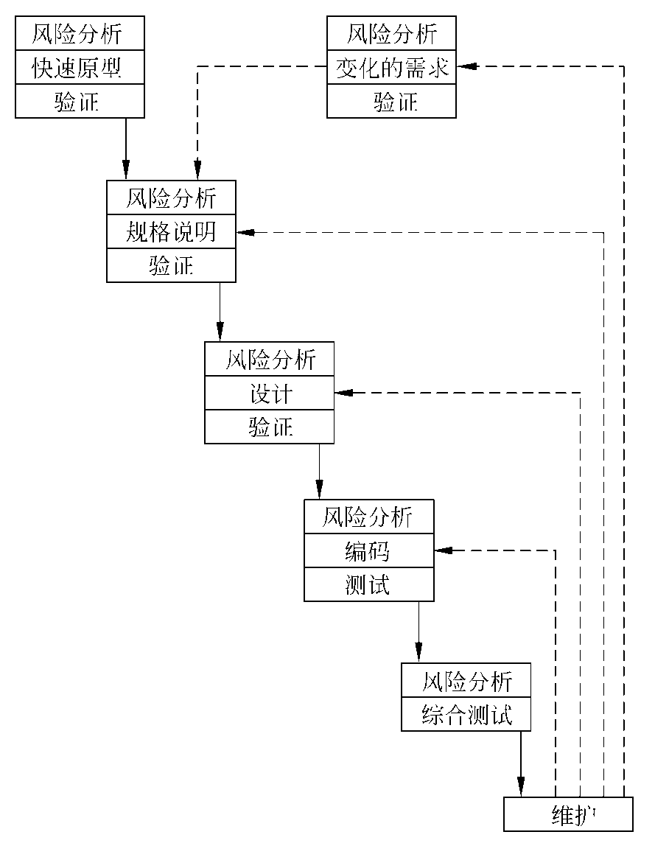
1.4 software process— Spiral model
The basic idea of spiral model is to use prototypes and other methods to minimize risks. Consider it as a rapid prototyping model that adds a risk analysis process before each stage.
螺旋模型的基本思想：使用原型及其他方法来尽量降低风险。把它看作在每个阶段之前都增加了风险分析过程的快速原型模型。
左图为简化的螺旋模型。
螺旋模型主要适用于内部开发的大规模软件项目。 如果进行风险分析的费用接近整个项目的经费预算，则风险分析是不可行的。事实上，项目越大，风险也越大，因此，进行风险分析的必要性也越大。此外，只有内部开发的项目，才能在风险过大时方便地中止项目。
Notes:
螺旋模型的基本思想是使用原型和其他方法来减少风险。把它看作是一个快速原型模型，在每个阶段之前增加一个风险分析过程。

Slide 19
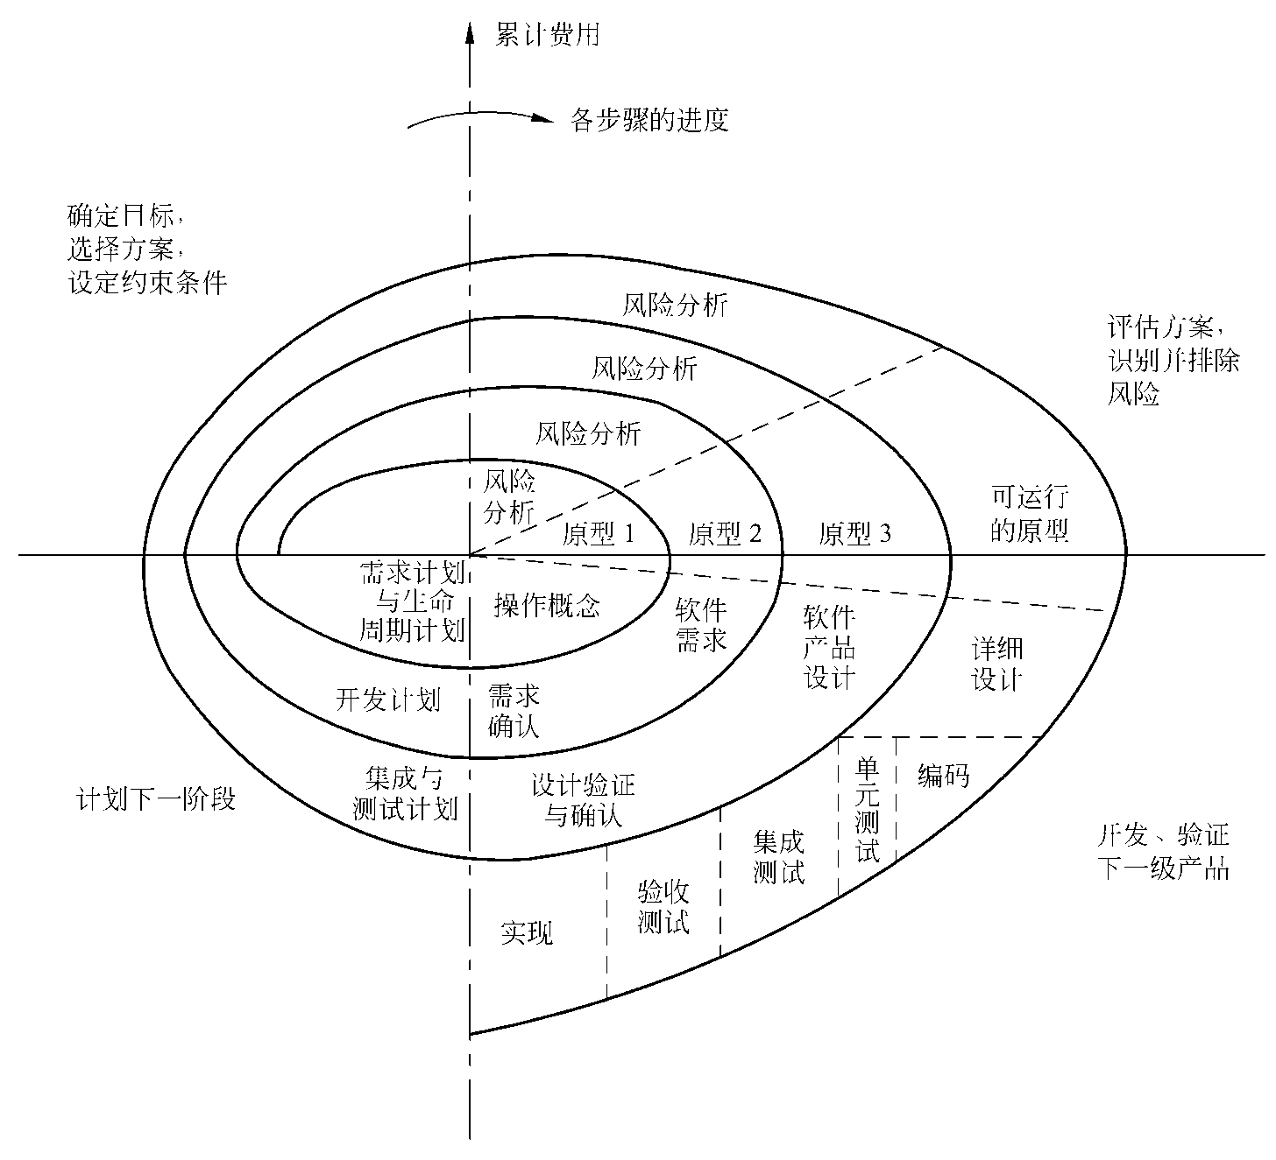
1.4 software process— Spiral model
The angle value of the spiral represents the development progress. Each cycle of the spiral corresponds to one development stage.
upper left quadrant: to determine the objectives of this stage, select the scheme for achieving these objectives and set the constraint conditions of these schemes.
upper right quadrant: to analyze the results of the previous step from the perspective of risk and try to eliminate various potential risks, usually by building prototypes.
downer right quadrant: pure waterfall model
Finally, evaluate the work results of this stage and plan the work of the next stage.
Notes:
螺旋的角度值代表发展进度。螺旋的每个周期对应一个发展阶段。
左上象限：确定这一阶段的目标，选择实现这些目标的方案，并设定这些方案的约束条件。
右上象限：从风险的角度分析上一步的结果，并试图消除各种潜在的风险，通常是通过建立原型。
右下象限：纯瀑布模型
最后，评估本阶段的工作成果，规划下一阶段的工作。

Slide 20
1.4 software process— Spiral model
Advantage:
The main advantage is that it is risk driven. The emphasis on alternatives and constraints is beneficial to the reuse of existing software, and also helps to make software quality an important goal of software development;
Reduce the risk caused by excessive testing or insufficient testing;
Maintenance is just another cycle of the model. There is no essential difference between maintenance and development.
Notes:
优势：
1. 主要优点是它是风险驱动的。强调替代方案和约束条件，有利于现有软件的再利用，也有助于使软件质量成为软件开发的重要目标；
2. 减少因过度测试或测试不足而造成的风险；
3. 维护只是该模型的另一个周期。维护和开发之间没有本质的区别。

Slide 21
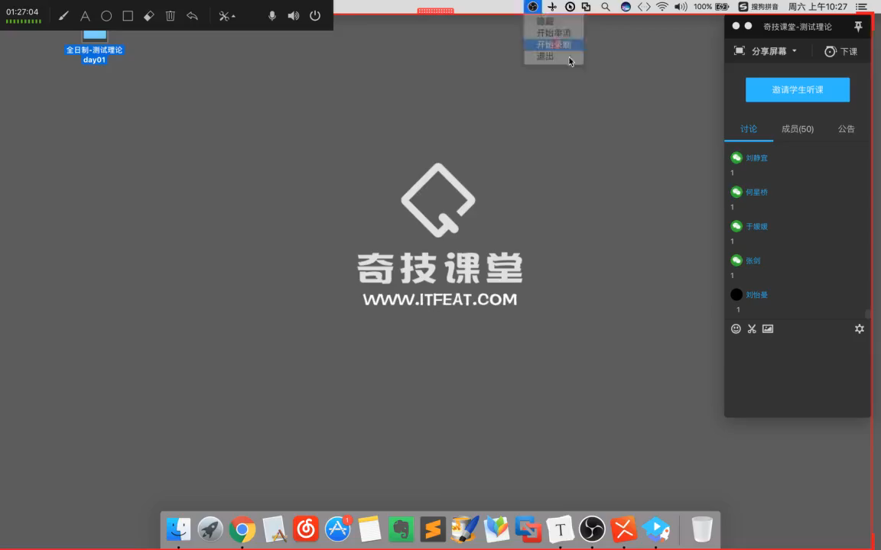
1.4 software process— Spiral model

Slide 22
1.4 software process— Fountain model
It is a model driven by user needs and driven by objects. It is mainly used for software development projects using object technology. It is mainly used in object-oriented software development.
In the fountain model, each stage of the software development process is iterative (迭代) and seamless (无缝).
A part of the software is often repeated many times, and the related objects add progressive software components in each iteration.
Seamless means that there is no obvious boundary between various activities, for example, there is no obvious boundary between analysis and design activities.
Notes:
它是一个由用户需求驱动、由对象驱动的模型。它主要用于使用对象技术的软件开发项目。它主要用于面向对象的软件开发。
在喷泉模型中，软件开发过程的每个阶段都是迭代的和无缝的。
软件的某一部分经常被重复多次，相关对象在每次迭代中都会增加渐进式的软件组件。
无缝意味着各种活动之间没有明显的界限，例如，分析和设计活动之间没有明显的界限。

Slide 23
1.4 software process— Fountain model
Advantage:
There is no obvious boundary between each stage of the model, and developers can develop synchronously.
Repeatedly increase or clarify the target system, rather than make essential changes, to reduce the possibility of errors.
Disadvantage:
Because the fountain model is overlapped in each development stage, a large number of developers are required in the development process, which is not conducive to project management.
Strict management of documents is required, which makes it more difficult to audit, especially when various information, demands and materials may be added at any time.
Notes:
优势：
模型的每个阶段之间没有明显的界限，开发者可以同步开发。
反复增加或澄清目标系统，而不是做本质的改变，以减少出错的可能性。
劣势：
因为喷泉模型在每个开发阶段都是重叠的，所以在开发过程中需要大量的开发人员，这不利于项目管理。
需要对文件进行严格的管理，增加了审核的难度，特别是在随时可能增加各种信息、需求和材料的情况下。

Slide 24
Software Engineering Overview—Homework
What are software and program?
What is software crisis?
What is a software process?
What are the phases of the software life cycle?
Waterfall model and rapid prototyping

