Slide 1
Software Engineering Introduction

Slide 2
Summary of chapter 1
Whether the software is equal to the program? Remember their differences.
Software crisis’ concept? what two aspects does it include?
The content and the time when it was proposed.
How to eliminate software crisis?
Software engineering’s concept.
Software engineering methodology definition, classification and key elements.
Software Development life cycle (three periods and eight stages)
Software process (several models)

Slide 3
2 Feasibility study
2.1 Tasks of feasibility study
2.2 Feasibility study process
2.3 System flow chart
2.4 Data flow diagram
2.5 Data dictionary
2.6 Cost / benefit analysis

Slide 4
2.1 Feasibility study’s task
Answer following question :
Is there a feasible solution to the defined problem?
Feasibility study’ purpose: To determine whether the problem has a solution and is worth solving in the shortest possible time with the minimum cost.
The time required for the feasibility study depends on the scale of the project, and the required cost accounts for 5% ~ 10% of the total project cost. (don't need to invest too much)
可行性研究的时间取决于项目的规模，所需费用占项目总成本的5%~10%。(不需要投入太多)

Slide 5
2.1 Feasibility study’s task
Further analysis and clarification of problem definition
Export the logical model of the system
Find possible solutions (System implementation)

Slide 6
2.1 Feasibility study’s task- Contents
Technical feasibility
Technical feasibility should analyze various technical factors, such as:
Can this system be implemented using existing technology?
Do they have the skilled technicians to develop the project?
Can the software and hardware resources required for the development of the project be obtained on schedule?

Slide 7
2.1 Feasibility study’s task- Contents
Economic feasibility
To evaluate the economic rationality 经济合理性, the issues need to be considered are:
Can the economic benefit of this system exceed its development cost?
This requires price / benefit analysis of the project, i.e. "input / output" analysis. Because benefit analysis depends on the characteristics of software systems, it is difficult to accurately and quantitatively describe the benefits of new systems before software development, so some estimation methods are often used.
这需要对项目进行价格/效益分析，即 "投入/产出 "分析。由于效益分析取决于软件系统的特点，在软件开发前很难准确、定量地描述新系统的效益，所以经常使用一些估算方法。

Slide 8
2.1 Feasibility study’s task- Contents
Operational feasibility操作可行性
The operational feasibility evaluation system will cause various changes after operation, such as the impact on the organization management mode and the working environment of users. 可行性评估系统运行后会引起各种变化，如对组织管理模式和用户工作环境的影响。
Social feasibility社会可行性
Social feasibility mainly discusses the feasibility of law and use.
For example, the ownership of the rights of the developed software and whether the technology used by the software will cause infringement.
社会可行性主要讨论的是法律和使用的可行性。
例如，所开发软件的权利归属，软件所使用的技术是否会造成侵权。

Slide 9
2 Feasibility study
2.1 Tasks of feasibility study
2.2 Feasibility study process
2.3 System flow chart
2.4 Data flow diagram
2.5 Data dictionary
2.6 Cost / benefit analysis

Slide 10
2.2 Feasibility study’s steps
Review system scale and objectives; 审查系统规模和目标
Confirm the target problem:
whether what the user needs is equal to what we think the user needs.
用户需要的东西是否等于我们认为用户需要的东西。
Study the system currently in use; 研究目前使用的系统
Tools: Documents ; User manual ; System flow chart
Do what? How to do? Cost? Interface?
Don’t learn the details of current system.

Slide 11
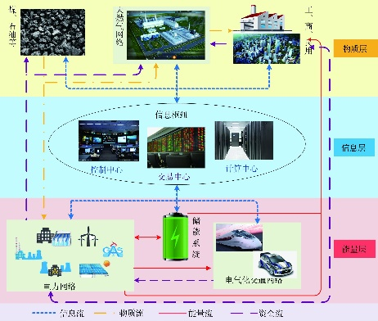
2.2 Feasibility study’s steps
Export the high-level logic model of the new system;输出新系统的高级逻辑模型；
Tools: data flow diagram(DFD), data dictionary
Current logical model
Target system’s logical model
Current Physical system
Build new physical system

Slide 12
2.2 Feasibility study’s steps
Redefine the problem;
Analysts and users should further review:
problem definition, project scale and purpose(目的)
Finding misunderstanding, missing part and so on………………
4
1
2
3
Problem definition
Problem analysis
Possible solution
Stages 1 - 4 form a cycle (until we find a proper logical model)

Slide 13
2.2 Feasibility study’s steps
Derive and evaluate alternative solutions (physical solutions); 推导和评估替代解决方案（物理解决方案）；
Based on the proposed system logical model, exporting some high-level physical solutions.
根据提出的系统逻辑模型，导出一些高层次的物理解决方案。
Eliminate some solutions by considering the following factors:
Technology, Operation, Economy 技术、运营、经济
The remaining solutions are possible solutions.
Finally, develop a schedule(制定一个时间表), and simply estimate the work of each stage in the SDLC.
Recommend action plans;
Which solution is the best? Why? Give a conclusion and reasons.

Slide 14
2.2 Feasibility study’s steps
Draw up a development plan; 拟定一个开发计划；
Task decomposition 任务分解
Determination of responsible person确定责任人
General schedule一般日程安排
Financial budget财务预算
Risk analysis and Countermeasures(对策)
Write documents and submit them for review
Users, customers, and other people further determine if this project should be continued and if the solution is acceptable.

Slide 15
2.2 Feasibility study’s steps
Feasibility report (Clear conclusions)
Yes or no.
Give the conditions that need to be met before the system starts给出系统启动前需要满足的条件

Slide 16
2 Feasibility study
2.1 Tasks of feasibility study
2.2 Feasibility study process
2.3 System flow chart
2.4 Data flow diagram
2.5 Data dictionary
2.6 Cost / benefit analysis

Slide 17
2.3 System flow chart
The physical system needs to be understood and analyzed in the feasibility study period.
System flow chart is a traditional tool to describe physical system.
The system flow chart reflects the flow of data among various parts of the system; (描绘数据在不同系统物理部件之间的流动)
System flow chart ≠ control and processing information
different from program flowchart

Slide 18
2.3 System flow chart —basic concept
Using graphic symbols to depict(描绘) each component of the system in the form of black boxes.
Thinking about what components do system include?
Program, document, database, and so on….

Slide 19
2.3 System flow chart —Symbols
符号
名称
说明
处理
如：程序，处理机，人工加工
输入/输出
表示输入或输出
Basic symbols
连接
同一页上图的连接
换页连接
不同页上图的连接
数据流
指明数据流动方向

Slide 20
2.3 System flow chart —Symbols
符号
名称
说明
穿孔卡片
穿孔卡片输入/输出，或穿孔卡片文件
文档
打印输出，或打印终端输入数据
磁带
磁带输入/输出，或表示磁带文件
联机存储
任何种类磁盘存储，如磁盘、磁鼓等
磁盘
磁盘输入/输出，或磁盘上文件、数据库
Other symbols
磁鼓
磁鼓输入/输出，或磁鼓上文件、数据库
显示
显示器部件
人工输入
人工输入数据，如填写表格
人工操作
人工完成的处理
辅助操作
使用辅助设备进行的脱机操作
通信链路
通过远程通信线路传送数据

Slide 21
2.3 System flow chart —Example 1
某装配厂有一座存放零件的仓库,仓库中现有的各种零件的数量以及每种零件的库存量临界值等数据记录在库存清单主文件中。当仓库中零件数量有变化时,应该及时修改库存清单主文件,如果哪种零件的库存量少于它的库存量临界值,则应该报告给采购部门以便定货,规定每天向采购部门送一次定货报告。
装配厂使用一台小型计算机处理更新库存清单和发起订货的任务。

Slide 22
2.3 System flow chart —Example 1
零件库存量的每一次变化称为一个事务，由存放在仓库的CRT（计算机远程终端，Computer Remote Terminal ）终端输入到计算机。
系统中的库存清单程序对事物进行处理，更新存储在磁盘上的库存清单文件，并把必要的订货信息写在磁带上。
由报告生成程序读一次磁带，并打印订货报告。
思考，并完成该系统流程图

Slide 23
2.3 System flow chart —Example 1
事务
库存清单主文件
库存清单程序
定货信息
报告生成程序
定货报告
图2.3 库存清单系统的系统流程图
符号表示系统部件
箭头表示信息流动路径

Slide 24
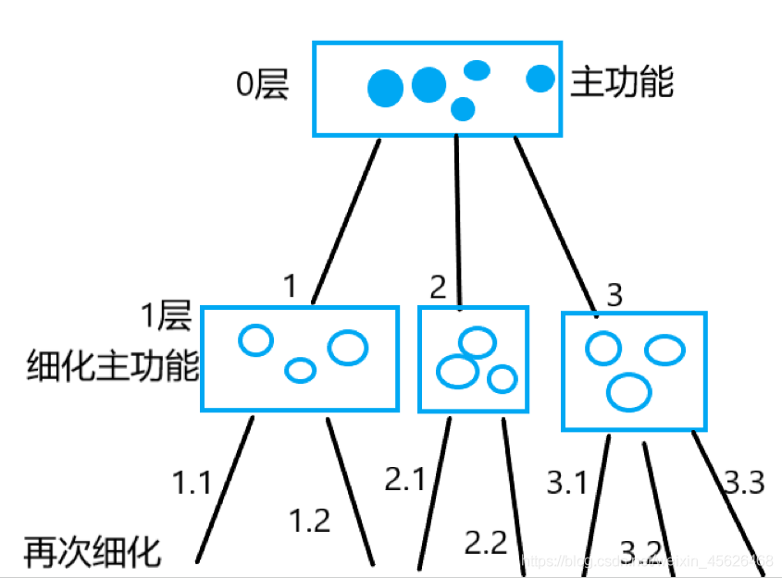
2.3 System flow chart
When facing a complex system, a better way is to describe the system hierarchically.
First, a high-level system flow chart is used to describe the overall overview of the system and show the key functions of the system. 首先，用一个高层次的系统流程图来描述系统的整体概况，并显示系统的关键功能。
Then expand each key function to an appropriate level of detail and draw it on a separate page.
然后将每个关键功能扩展到适当的详细程度，并将其画在单独的一页上。
This hierarchical description method facilitates(方便) readers to understand a complex system step by step from abstract 抽象to concrete具体.

Slide 25
2.3 System flow chart —Example 2
某高校为了方便教师备课学习，建立了专业教师图书室。图书室所有书籍均由教师个人采购。报销过程是：购书者凭发票和图书到教务处进行审查（是否为专任教师，专项资金）；通过后，购书者带书去图书室登记入库；最后，购书者凭借入库证明和发票到财务处报销；
发票
专业教师登记表
终端
审查
专项基金文件
入库通知单
图书馆
清单
书入库
入库证明
报销

